Slide 1
SECURITY TOOLS AND FEATURES OF AZURE

Slide 2
Agenda
Azure Security Center
Azure Key Vault
Azure Information Protection
Azure Advanced Threat Protection

Slide 3
Azure Security Center
Azure Security Center is a service in Azure that offers you a single portal for monitoring and managing the security of your Azure resources. You can also add on-premises resources to Security Center by installing a Security Center agent on your on-premises resources.
Security Center offers two tiers of service.
The free tier provides general assessment and recommendations for securing your Azure resources and covers only Azure virtual machines and Azure App Service.
The Standard tier adds coverage of your Azure SQL Databases, MySQL databases, PostgreSQL, and Azure blob storage, as well as additional features such as advanced threat detection, analysis from Microsoft Threat Intelligence, and the ability to manage the regulatory compliance of your Azure resources. The Standard tier is billed by the hour, and full details on pricing can be found at https://azure.microsoft.com/en-us/pricing/details/security-center.

Slide 4
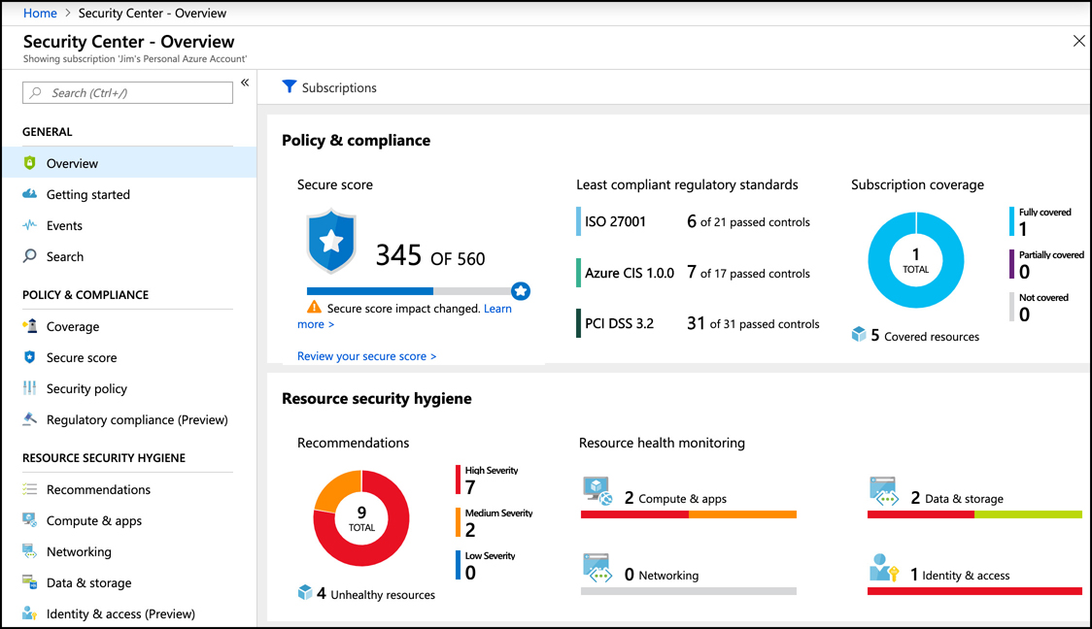
Azure Security Center
To get started with Security Center, click Security Center in the menu in the Azure portal.

Slide 5
Azure Security Center
There are three primary areas of coverage in Security Center.
Policy & Compliance Provides a secure and overall score of how secure your resources are. This area also covers your compliance with regulatory standards.
Resource Security Hygiene Provides a high-level overview of the health of your resources from a security perspective. Security issues are categorized as high, medium, or low severity.
Threat protection Shows you any active or past attacks or threats on your resources.
Microsoft Threat Intelligence is used to identify security threats. Threat Intelligence uses Microsoft’s historical data and machine learning to identify possible threats. These threats could be a hacker attempting to gain access to a resource, or they could be related to suspicious activity performed by a user.

Slide 6
Azure Security Center
By clicking on an item in the Overview blade, you can drill down into more details. You can can see all of the recommendations for the VMs, App Service, cloud services, and container resources. You can also see how much your secure score will improve if you address each recommendation.
Clicking on one of the recommendations will provide additional information. In most cases, you’ll see a link to instructions on how you can address the recommendation, but Security Center has the ability to automatically take care of recommendations.

Slide 7
Azure Security Center
One of the greatest security threats to your cloud resources is open network ports on your VMs. Accessing your VMs using the remote desktop for Windows VMs, or SSH for Linux VMs, is a necessary part of managing those resources, but hackers commonly use the network ports used for remote management to break into VMs. Security Center provides a feature called just-in-time (JIT) access that helps to protect your VMs from attacks on management ports.
When JIT access is enabled, users must request access to a VM in order to remote into it. Until someone is given JIT access, management ports on the VM are closed so they can’t be accessed. Once JIT access is given to a user, the ports are open for a specific period of time as requested by the user. Once that time period has elapsed, the management ports are closed again.
To enable JIT access on a VM, click on Just In Time VM Access in Security Center. Click on the Recommended tab to see VMs that are currently not configured for JIT access. Select one or more VMs and click Enable JIT to turn on the feature.

Slide 8
Azure Security Center
When enabling JIT access, you can choose which ports you want to protect. The recommended ports for management are listed, but you can add your own ports.
In addition to specifying the port, you can also control which protocols are allowed over the port and which IP addresses are allowed. If the allowed IPs are set to Per Request, the user who requests access will have the option of specifying an IP address or a CIDR block. Otherwise, you can specify a CIDR block yourself in order to allow access only from a specific IP address range.
When a user requests access, the number of hours that access is given can be specified up to the maximum number of hours you specify in the port configuration. Maximum request time can be configured anywhere from 1 to 24 hours.
Once a VM is configured for JIT access, users request access from inside of Security Center. After clicking on Just in Time VM Access, select the VM and click Request Access.
Users requesting access must specify which ports to open, the IP addresses that are allowed (assuming they weren’t specified when JIT access was enabled for the VM), and how long access is needed, up to the maximum time configured. Once Open Ports is clicked, the requested ports will remain open for the period specified.

Slide 9
Agenda
Azure Security Center
Azure Key Vault
Azure Information Protection
Azure Advanced Threat Protection

Slide 10
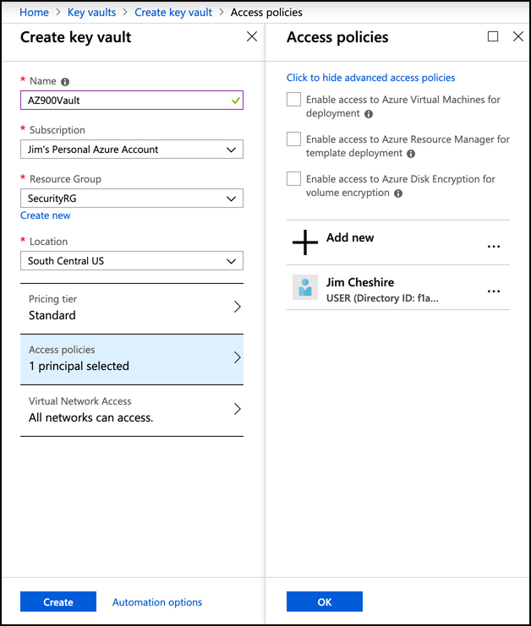
Azure Key Vault
Azure Key Vault provides a secure way to store secrets, keys, and certificates. Once an item is stored in Key Vault, you can apply security policies that define which users and applications can access it. Key Vault is encrypted using encryption keys, but Microsoft has no visibility into the encryption keys or the encrypted data.

Slide 11
Azure Key Vault
There are two pricing tiers available in Key Vault: Standard and Premium. The only difference between the two is that keys are stored in hardware security modules (HSMs) in the Premium tier. An HSM is a separate piece of hardware that is designed for securely storing encrypted content, and it’s also specialized for processing cryptographic data.
You can import a key, secret, or certificate into Key Vault, but Key Vault can also generate security keys and certificates for you. For example, you may want to generate a security key that your company can use to sign certificates. If you want to generate a 4,096-bit security key for this purpose and store it in Key Vault, click on Keys and then click Generate/Import.
Once the key has been stored, you can view the entry to get the key identifier, a URL that can be used to retrieve the key by users or applications that are authorized. However, you cannot view the key because it’s encrypted and not available except through the key identifier.

Slide 12
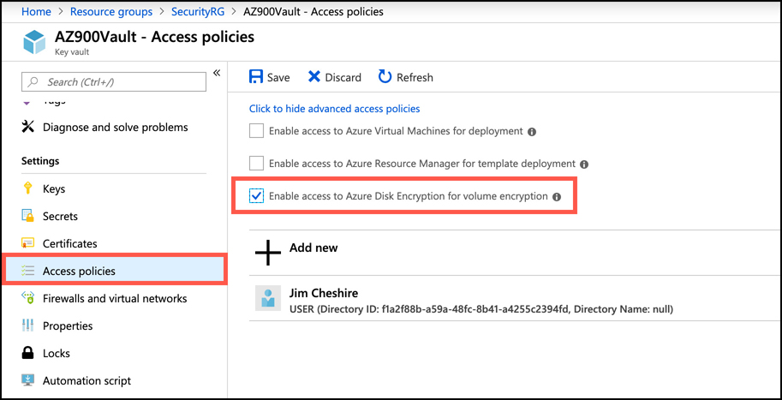
Azure Key Vault
Another common use scenario for Key Vault is to store encryption keys for Azure VMs. One of the security recommendations offered by Security Center is to encrypt VM disks. A VM disk is stored as a VHD file, and when it’s encrypted, the host operating system that runs the VM must be able to access the security key in order to decrypt the VHD and run the VM. Key Vault offers capabilities that are specifically targeted at this kind of scenario.
In order to use Key Vault for disk encryption keys, the access policies must be configured to allow the vault for disk encryption. If this wasn’t done when the vault was created, you can change it by clicking Access Policies, and checking the option to enable access to Azure Disk Encryption.

Slide 13
Agenda
Azure Security Center
Azure Key Vault
Azure Information Protection
Azure Advanced Threat Protection

Slide 14
Azure Information Protection
There are often situations where sensitive or confidential information is shared outside of your company. For those situations, Azure Information Protection (or AIP) can help you to keep information within your control.
AIP protects emails and Microsoft Office documents from reaching the wrong hands. By configuring different classifications for emails and other documents, and then specifying restrictions that apply to each classification, a company can ensure that information isn’t over-shared or that sensitive information doesn’t leave the company.

Slide 15
Azure Information Protection
Example: An email is being sent that contains a credit card number. In order to prevent my credit card from being used by someone inappropriately, you can use AIP to classify the email so that only the recipient you specified can read it.
The Protect button in Microsoft Outlook allows you to easily categorize and protect your email. By clicking on the Protect button, you can mark this email so that it can only be read by the recipient that it’s addressed to.
This message can be read by a recipient who’s using Microsoft Outlook. If the recipient isn’t using Microsoft Outlook, a link to read the message will be available. Clicking that link will send the user a single-use passcode that they can enter to read the email message in Office 365 in a web browser. This passcode will work even if the user isn’t an Office 365 subscriber.
AIP can also be used to protect Office documents in the same way. You can even control whether users can edit the document or just read its contents. If a user doesn’t have the Office app used to create the document, it will open in Office Online in a web browser.

Slide 16
Agenda
Azure Security Center
Azure Key Vault
Azure Information Protection
Azure Advanced Threat Protection

Slide 17
Azure Advanced Threat Protection
One of the most common attack vectors (and one that is often most difficult to detect), is an attack on a user’s identity within your on-premises environment, or via other devices employees use to connect to your network. Attacks on your cloud resources are often begun on-premises, or on mobile devices where the target may not be as hardened.
These types of attacks are difficult to detect because they often look like legitimate traffic. Hackers will enter your environment on one machine using stolen credentials, and they’ll move laterally through your infrastructure attempting to gain access to additional systems and sensitive data. Mobile devices are also a common attack vector because they can connect to insecure networks.
Azure Advanced Threat Protection (or ATP) is available as part of the Enterprise Mobility + Security 5 suite from Microsoft. You can also purchase it using a standalone license. ATP is designed to identify and mitigate identity threats in your on-premises environment and on devices that connect to your environment.

Slide 18
Azure Advanced Threat Protection
Step 1: Determine Capacity
ATP collects information on your network, servers, and environment using software that you install called an ATP sensor. In order to plan your ATP capacity, you need to determine how many sensors you need and what size those sensors should be. (Sensor size is based on the volume of network traffic in your environment.)
Microsoft has a guide on planning your ATP capacity at: https://docs.microsoft.com/azure-advanced-threat-protection/atp-capacity-planning.
Step 2: Create an Instance of Azure ATP
The ATP sensors that you install on-premises will connect to an Azure ATP instance in the cloud. That’s where they will store all the data that’s collected in order to do threat analysis and detection.
Your Azure ATP instance is created by browsing to the Azure ATP portal at https://portal.atp.azure.com. You’ll need an Azure ATP license in order to access this site.

Slide 19
Azure Advanced Threat Protection
Step 3: Connect ATP To On-Premises Active Directory
Azure ATP connects to your on-premises Active Directory in order to get information about your environment and your users. You can also connect to a multi-forest Active Directory.
Full details on how to connect ATP to your Active Directory are available at: https://docs.microsoft.com/en-us/azure-advanced-threat-protection/install-atp-step2.
Step 4: Download, Install, and Configure the ATP Sensors
The ATP sensors are available in a package from Microsoft. Once you download and install the ATP sensor, you’ll need to configure it before you’ll start seeing data.
You can find details on the ATP sensor installation and configuration at: https://docs.microsoft.com/en-us/azure-advanced-threat-protection/install-atp-step3.
Once installed and configured, ATP is able to use its analytics and machine learning to identify what’s normal and what’s not, and it does this in real-time. If an attack occurs, ATP can provide tools to your IT department to investigate the nature of the attack and take appropriate actions.

